Slide 1
Career Preview Program project
23th July 2025

Slide 2
Text-2-SQL, Text-2-PL/SQL code generation and execution
Project Name :Text-2-SQL, Text-2-PL/SQL code generation and execution
Project Id- 11
College / University Name : JECRC Foundation / JECRC University
Project Participants: Vidhi Sharma
Raunak Jain
Vishesh Jain
Anshul Suwalka
Priyanshi Sharma
Mentor Names : Mr. Karthikeyan Soundararajan (HPE Mentor)
Ms. Meghna Sharma (College Mentor)
Project Code Link/GitHub: https://github.com/Vish2503/Text2SQL-Qwen/
Working Demo: https://www.youtube.com/watch?v=yFsXRy-tW6M

Slide 3





Text-2-SQL, Text-2-PL/SQL code generation and execution
Problem statement: Text-2-SQL, Text-2-PL/SQL code generation and execution
Accessing data in relational databases requires SQL/PL-SQL knowledge, which limits non-technical users from retrieving insights independently. Writing SQL is also time-consuming and error-prone, especially with complex schemas or multi-table queries.
This project aims to build a system that uses Generative AI and LLMs to convert natural language into accurate, executable SQL/PL-SQL queries. The system will:
The goal is to provide a reliable, schema-aware, end-to-end solution with >90% query accuracy—empowering users to access data without writing code.
Generate valid DML
queries
Understand user intent in plain English
Execute them in real-time via a user-friendly UI
Inference
Dynamically retrieve schema context

Slide 4


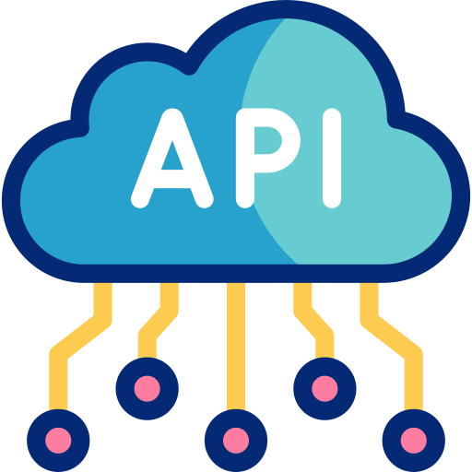
Text-2-SQL, Text-2-PL/SQL code generation and execution
Solution Proposal:
We propose an end-to-end AI system that converts natural language into executable SQL queries using LLMs. Here’s how we built it:
1. Initial Architecture & Planning:
Defined the objective: Convert natural language into executable SQL.
Designed a modular pipeline with frontend (UI), backend (LLM), and database layer.
Chose SQLite/PostgreSQL for testing with custom schemas.
2. Baseline Model: Wiki-SQL (T5-base)
Integrated mrm8488/t5-base-finetuned-wikiSQL model.
Achieved quick prototyping and initial validation using simple, single-table queries.
Limitations: No JOINs, subqueries, or schema adaptability.
3. Advanced Model: Gemini API
Used Google Gemini 1.5 Flash via API for more complex query generation like joins and sub-queries.
Added schema-guided prompt templates with examples.
Improved accuracy for basic multi-condition queries, but limited control and privacy due to API dependency.

Slide 5





Text-2-SQL, Text-2-PL/SQL code generation and execution
The final product is a fully functional, end-to-end Text-to-SQL system that allows users to query a relational database using plain English. It features:
User Interface
Built with Stream lit, the UI lets users input natural language queries and view the generated SQL along with real-time results.
Scalable & Modular Design
The architecture supports future upgrades (e.g., PL/SQL logic blocks, multi-database support) and can be integrated into enterprise applications.
Schema-Aware Query Generation
Incorporates RAG (Retrieval-Augmented Generation) to fetch relevant schema definitions dynamically from the database, reducing hallucination and improving accuracy.
Final System
Qwen2.5-Coder
Chain-of-Thought Reasoning
Model explains its steps before generating SQL, offering transparency and making it easier to debug or understand how queries are formed.
Execution Engine
Validates and executes SQL statements in real-time using PostgreSQL and displays outputs within the UI.
Local LLM Backend
Uses the Qwen2.5-Coder-7B-Instruct model, deployed locally with quantization (4-bit) to ensure fast performance on standard hardware while maintaining user data privacy.

Slide 6
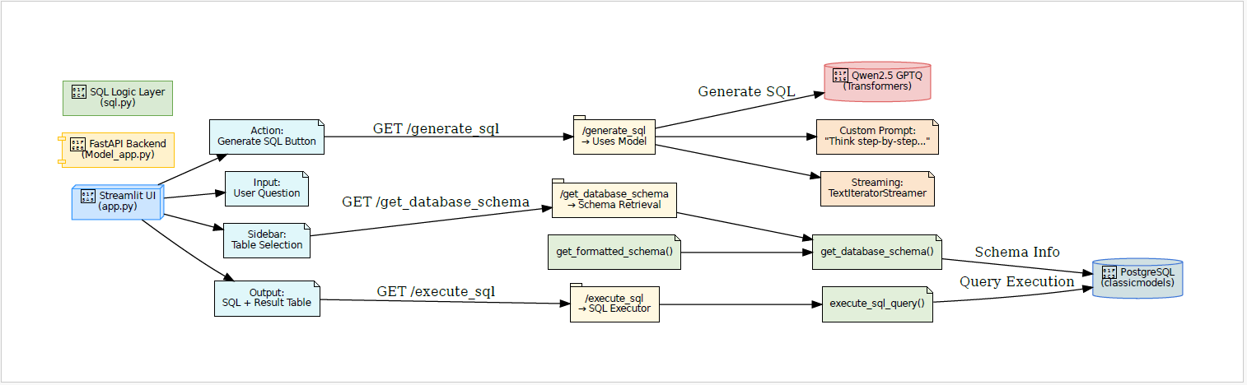
Text-2-SQL, Text-2-PL/SQL code generation and execution
System Architecture
System Architecture

Slide 7
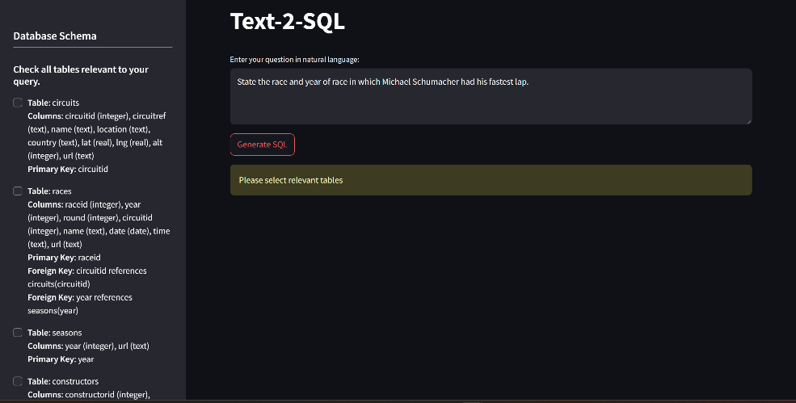
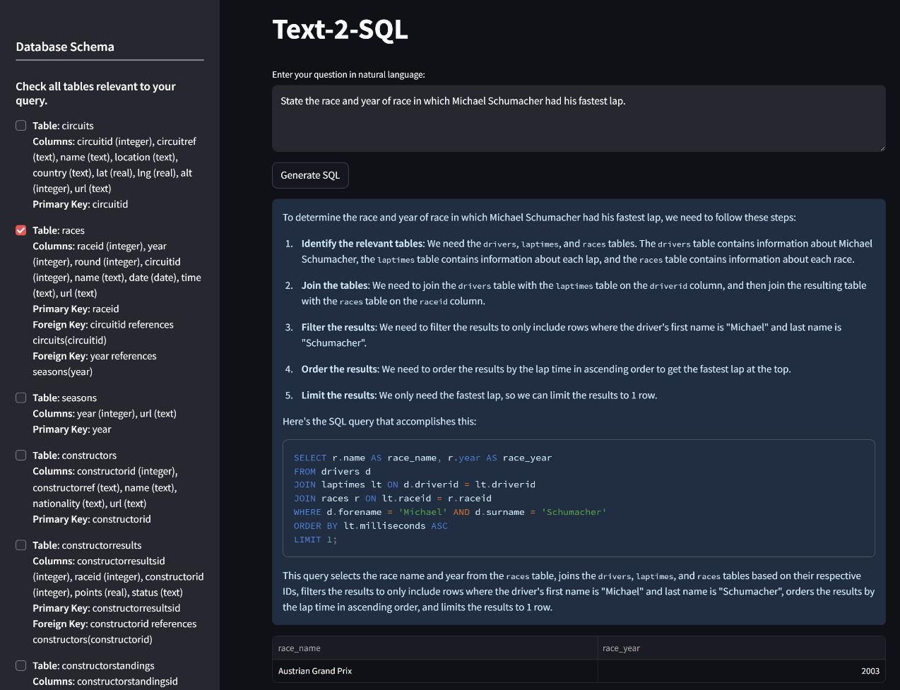
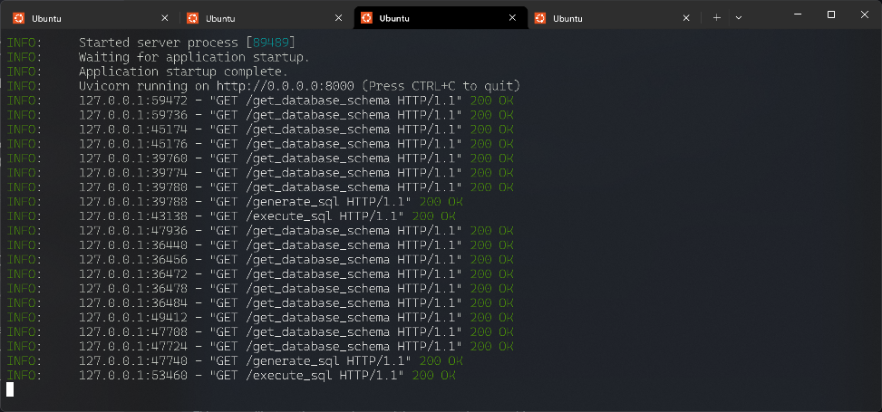
Text-2-SQL, Text-2-PL/SQL code generation and execution
Project Demo

Slide 8
Text-2-SQL, Text-2-PL/SQL code generation and execution
MODELS COMPARISON
Feature / Limitation | Wiki-SQL (Baseline) | Gemini API (Intermediate) | Qwen2.5 + RAG (Final)
Query Complexity | ❌ Simple (no JOINs, subqueries) | ✅ Moderate (multi-condition support) | ✅✅ Complex with schema awareness
Schema Adaptability | ❌ Hardcoded or none | ⚠Partial via prompt tuning | ✅ Dynamic via RAG
Privacy & Control | ✅ Local | ❌ API-dependent (cloud) | ✅ Full local privacy
Explainability | ❌ None | ❌ None | ✅ Chain-of-Thought reasoning
Deployment Type | ⚠ Limited | ❌ API-based | ✅ Streamlit + FastAPI locally

Slide 9



Text-2-SQL, Text-2-PL/SQL code generation and execution
End Product:
Fully working Text-to-SQL solution with schema awareness, live query execution, and accuracy >70%.
Enables non-technical users to interact with relational databases using natural language.
Optimization:
Streamlining Model Output to Frontend
Schema-Aware Prompt Engineering
Dynamic Database Schema Retrieval
Clean Modular Backend (Fast-API)
Error Handling in API Calls
Use Cases
Data Querying in Internal Dashboards
Self-service analytics for business teams
Education and Training Tools
Customer Support & Chatbot Assistants

Slide 10

Text-2-SQL, Text-2-PL/SQL code generation and execution
Testing and Evaluation:
1. Execution-Based Evaluation:
Both predicted and actual SQL queries are executed on a live PostgreSQL database, not just compared as strings.
2. Dataset Used:
A cleaned and schema-rich subset of the Bird dataset (mini_dev_postgressql.json) , known for:
Multi-table queries
Join logic
SQL with aggregation and conditions
3. Quantized Model Shows Competitive Accuracy:
Inference: Despite quantization, the model achieves strong performance — which is efficient and memory-friendly.
4. Observed Accuracy: 70–80%
The system achieved ~70–80% execution accuracy on the mentioned dataset.
Reflects that the model handles:
Basic SELECT queries
Column filters
Joins with PK–FK relations well.

Slide 11
Text-2-SQL, Text-2-PL/SQL code generation and execution
Aspect | General purpose LLMs like ChatGPT/Copilot | Our Text-to-SQL System
1. Use Case | General-purpose assistant for text, code, documentation | Specialized tool for querying databases using natural language
2. Schema Awareness | No built-in knowledge of live DB schema | Dynamically fetches schema from PostgreSQL using RAG
3. Query Accuracy | Prone to hallucinations, especially on unseen schema | Schema-aware prompts + live retrieval improve SQL accuracy
4. Execution | No built-in query execution — generates text only | Executes SQL in real-time and displays results via Streamlit UI
5. Transparency | Limited explanation of how output was generated | Uses Chain-of-Thought reasoning for query explainability
6. Privacy / Hosting | Cloud-based, data goes to external servers | Runs fully locally — safe for internal and sensitive data
7. Integration | Not directly integrated with DB systems | Modular backend with FastAPI — easily connects to relational DBs
8. Target User | Developers, Coders | Business Users, Analysts, Students along with Developers and Coders.

Slide 12

Text-2-SQL, Text-2-PL/SQL code generation and execution
Key Learnings:
Gained hands-on experience with Generative AI and Large Language Models (LLMs) for structured query generation.
Understood the limitations of baseline models like Wiki-SQL and how advanced models solve real-world constraints.
Learned to deploy LLMs locally with quantization to balance performance and resource usage.
Implemented schema-aware prompt engineering and RAG, which significantly improved query relevance and reduced hallucinations.
Developed a full-stack system with Stream lit (frontend) and FastAPI (backend) for real-time interaction.
Realized the importance of Chain-of-Thought reasoning in improving model explainability and trustworthiness.
Improved collaboration and project planning skills through phased development, model comparison, and iterative improvements.

Slide 13
Text-2-SQL, Text-2-PL/SQL code generation and execution
Conclusion:
Easy Database Access: Lets users query databases using simple language—no SQL knowledge needed.
AI-Powered: Uses local LLMs (like Qwen2.5) and RAG to convert natural language to SQL accurately.
Schema-Aware: Checks database structure in real-time for correct query generation.
Transparent: Explains how each SQL query was created for trust and debugging.
Performance: Achieves 70-80% accuracy in generating correct queries.
Security:
Runs locally (no risky cloud dependencies).
Follows OWASP security standards to prevent SQL injection and data leaks.
Fast & Efficient: Optimized for quick responses.
Future Upgrades: Could support complex logic (PL/SQL) and multiple database types.

Slide 14
Thank YOU

